Slide 1
Mini Project 2 (Classification model)

Slide 2
AGENDA
Scoping the Problem
Understanding/Cleaning the Data
Visualising the Data
Supervised Learning
Business Recommendation

Slide 3

Problem scoping

Slide 4
MOST COMMON QUESTIONS
What is the problem? | Many students are unsure about their career paths before college. To assist, I've developed an ML model that answers career questions and provides income insights for businesses.
Who is affected and How? | Individuals Employers
What is the value of solving it? | Informed Decision-Making Understanding Income Inequality
Notes:
Who is affected and How?
1 - Individuals:
Job Seekers: Understanding income determinants can help job seekers identify which factors (e.g., education, occupation) are most influential in earning higher wages.
Employees: Current employees can use this information to make informed decisions about their career paths, educational advancement, or geographical location changes to improve their earning potential.
2 - Employers:
Recruiters: Employers can utilize this data to set competitive salaries and understand the market better, potentially improving employee satisfaction and retention.
Policy Makers: Data can help identify wage gaps and inequalities based on race, gender, or other demographic factors, enabling targeted policy interventions.
What is the value of solving it?
1- Informed Decision-Making: Businesses can make data-driven decisions about salary structures, hiring practices, and employee benefits.
2- Understanding Income Inequality: Analyzing the dataset helps identify factors that contribute to income disparities, which is critical for addressing income inequality.

Slide 5
Sourcing datasets on kaggle

Slide 6

Adult census Income
Target: Predict where income exceeds $50K/year based on census data
Adult Census Income

Slide 7
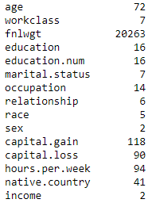
Understanding the dataset
Columns
Sex (Gender) | Fnlwgt (Final Weight) | Education Number | Hours per week | Native Country
Age | Occupation | Education | Relationship | Capital Gain
Race | Income | Work class | Marital Status | Capital Loss
Some columns have to be LabelEncoded (LE) as there is too many variables to use Mapping
Columns needed to be Label Encoded

Slide 8
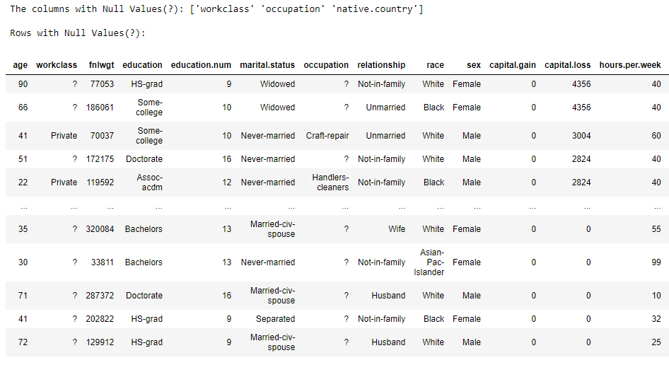
Cleaning THE DataSET
Dataset had no null values but instead had '?' Dropped all rows/columns with '?' As it is only 8% of the Dataset.
Final Shape: (30162, 15)

Slide 9
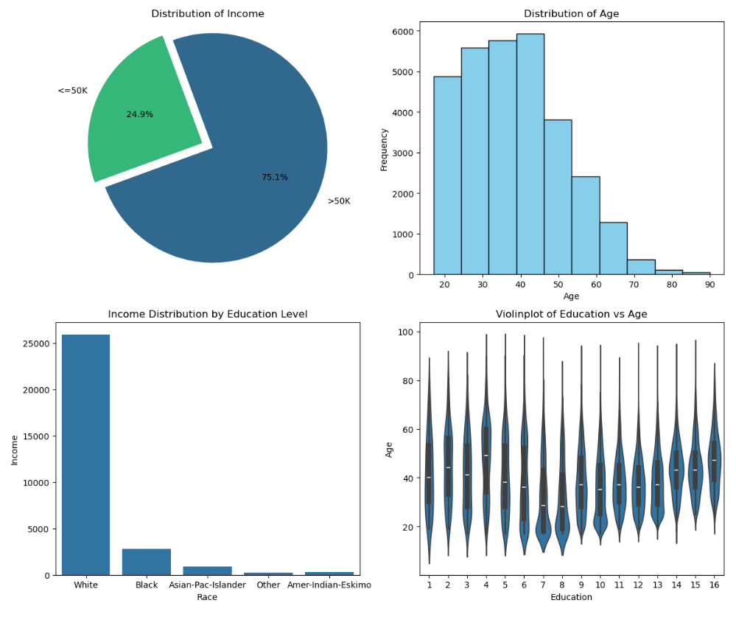
Graphs of the dataset
More than half of participants are younger than 50
75% has income higher than $50K
Predominantly White people earn a higher income
Education Levels increase with age

Slide 10
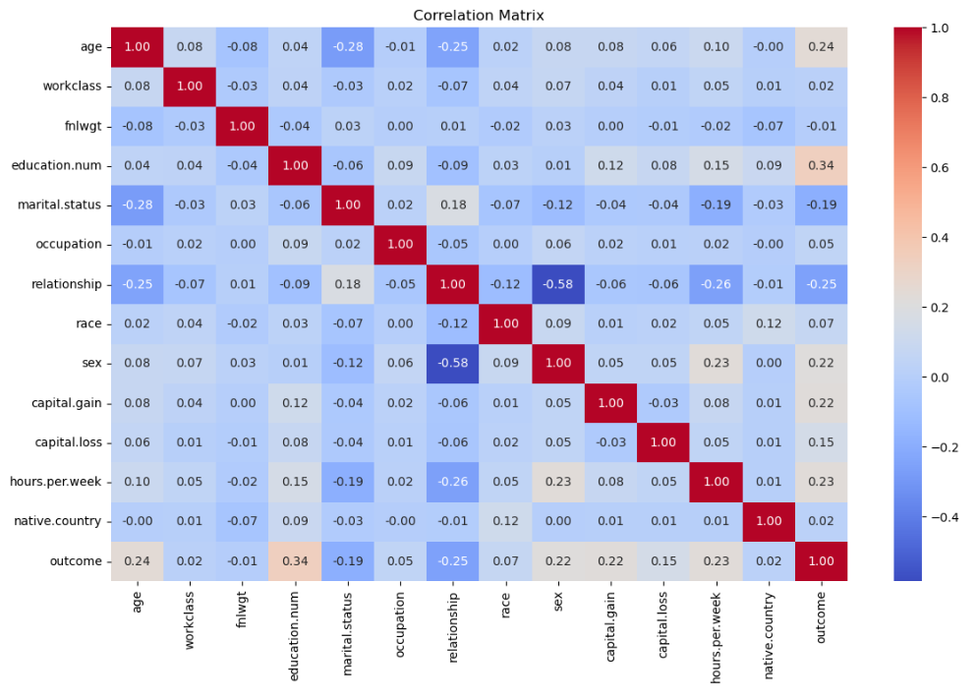
Correlation
Features affecting the 'Outcome' the most are:
Education
Age
Hours per Week
Sex
Capital Gain

Slide 11


Applying supervised learning (Classification Problem)
X (Feature Variables) | Age, Work Class, Final Weight, Education Number, Marital Status, Occupation, Relationship, Race, Sex, Capital Gain/Loss, Hours per week & Native Country
Y (Target Variable) | Income/Outcome

Slide 12
Machine LEARNING PROCESS
Defining & Scaling Train/Test Split
Inputting Estimators
Defining:
X_train, X_test, y_train, y_test = train_test_split(X, y, stratify=y, test_size=0.2, random_state=42)
# Scaling the features
scaler = StandardScaler()
X_train = scaler.fit_transform(X_train)
X_test = scaler.transform(X_test)
Estimators (Random State = 42):
Logistic Regression
Random Forest Classifier
Decision Tree Classifier
Gaussian Naïve-Bayes

Slide 13
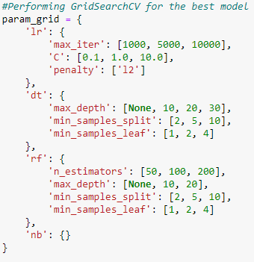
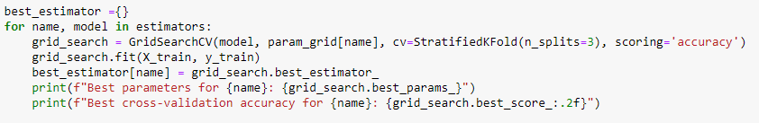
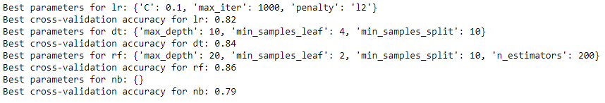
MACHINE LEARNING PROCESS
Parameter Grid
GridSearch CV

Slide 14
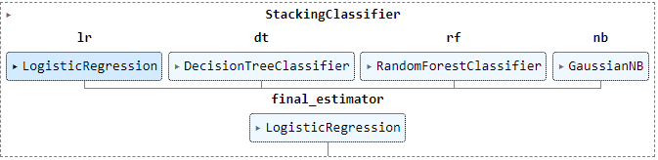
MACHINE LEARNING PROCESS
Stacking Classifier
Fitting the model
scf = StackingClassifier
Hyperparameters:
estimators=best_estimators
final_estimator=LogisticRegression(max_iter= 1000, C= 0.1, penalty= 'l2', random_state= 42))
scf.fit(X_train, y_train)

Slide 15
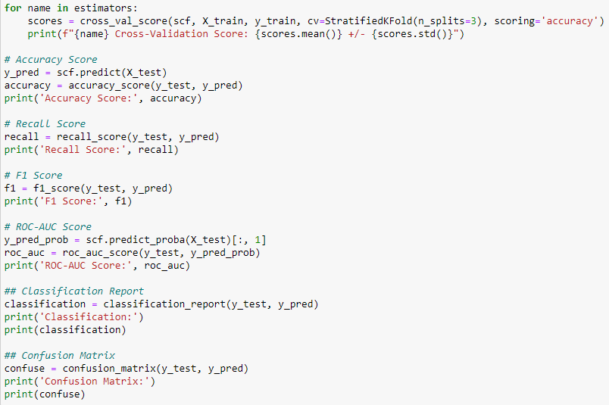
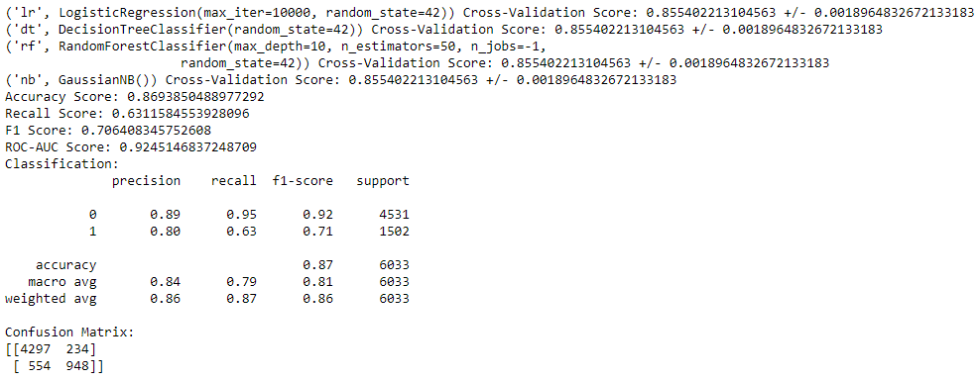
MACHINE LEARNING PROCESS
Checking Scores
Results
Not bad!

Slide 16
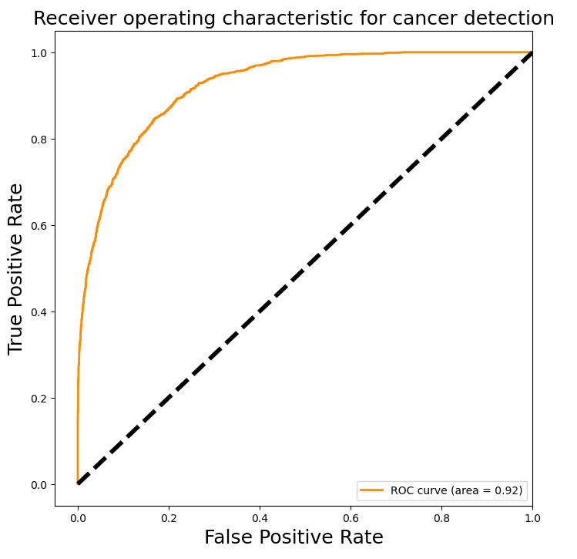
Receiver operating characteristic (roc)
What can we deduce from this graph?
Area Under Curve (AUC) | The AUC is 0.92. This directly translates to a high level of accuracy in distinguishing the two classes
Curve | Close to the top-left corner = High TPR and Low FPR This means the model performs well in detecting True positives while minimizing false positives
Overall | This model is performing excellently and can be used safely with a 8% chance of being wrong

Slide 17
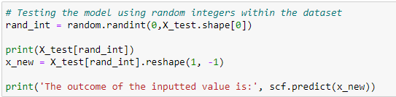
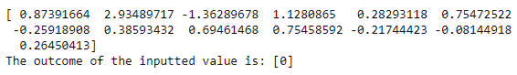
Testing the model (DATASET)
Input Variable from the dataset
Results

Slide 18
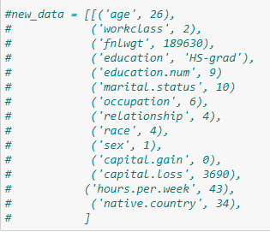
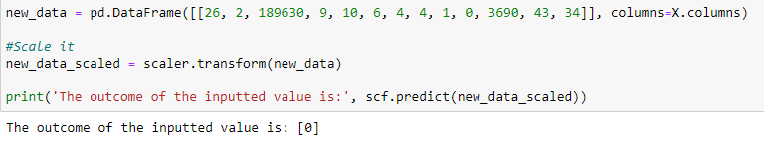
TESTING THE MODEL (manually)
Input New Variables
Results

Slide 19


Business Recommendations
Targeted Training Programs
Employee Retention
Implement training programs focusing on skill development in high-paying occupations
Implement retention strategies tailored to employees with promising future.

Slide 20


Areas of improvement
Improve Data Collection
Improve Employee Education and Training
Enhance the quality and scope of data collected regarding employee demographics and performance.
Invest in continuous education and professional development programs.

Slide 21



Limitations
Imbalanced Dataset
Outdated Dataset
More than $50k is at 75% while lesser is at 25%.
This dataset was last updated 8 years ago.

Slide 22


Additional data suggestions
Current Market Data
Performance Data
Data reflecting current economic conditions and salary trends.
Data on employee performance, productivity and overall job satisfaction.

Slide 23

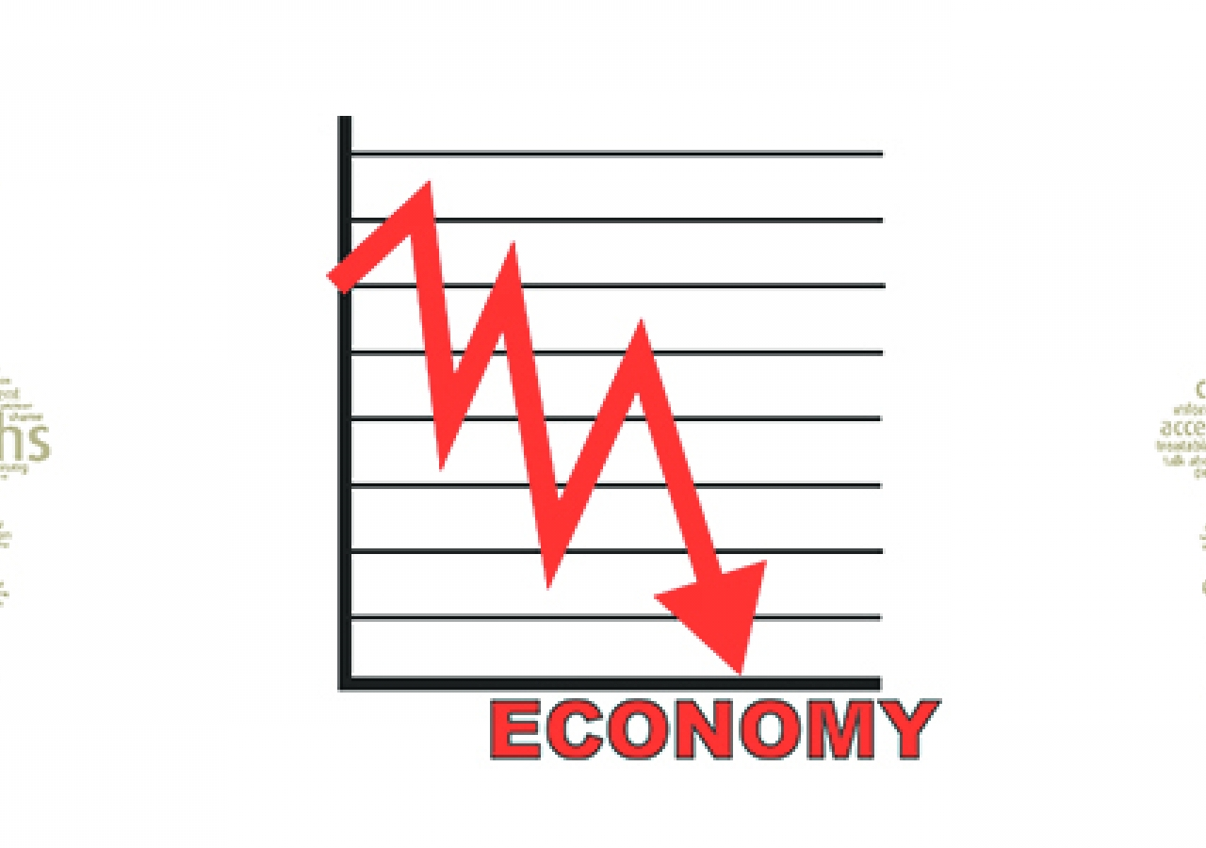
ASSUMPTIONS MADE
Data Accuracy
Similar Economic Conditions
The data is accurate and reflects the demographics and income levels of the current population
The economic conditions will remain static or similar to when the data was originally collected.(eg. Covid-19)

Slide 24
THANK YOU
~Ahmad Harith

